Slide 1


God’s plan in our lives
Please start slideshow to listen to audio with timed slideshow.

Slide 2

God’s plan
Does God have a plan for our life or not?
If yes, to what extent? Does God have a plan for the details of our life, such as career, job, partner, house etc.

Slide 3

God knows about us – Old Testament
Romans: 12:1-2
What does it mean that God has a plan and a purpose for your life?
“You have searched me, Lord, and you know me. You know when I sit and when I rise; you perceive my thoughts from afar. You discern my going out and my lying down; you are familiar with all my ways. Before a word is on my tongue, you, Lord, know it completely.” (Psalm 139:1-24)

Slide 4

God knows about us – New Testament
“Are not two sparrows sold for a copper coin? And not one of them falls to the ground apart from your Father’s will. But the very hairs of your head are all numbered. Do not fear therefore; you are of more value than many sparrows.” (Matthew 10:29-31)
“I am the good shepherd; I know my sheep and my sheep know me.” (John 10:14)

Slide 5

God has a plan for us
“For I know the plans I have for you, declares the Lord, plans for welfare and not for evil, to give you a future and a hope.” (Jeremiah 29:11)
“Before I formed you in the womb I knew you, and before you were born I consecrated you; I appointed you a prophet to the nations.” (Jeremiah 1:5)
“But when God, who set me apart from my mother’s womb and called me by his grace, was pleased to reveal his Son in me so that I might preach him among the Gentiles …” (Galatians 1:15-16)
“Trust in the Lord with all your heart, and do not lean on your own understanding. In all your ways acknowledge him, and he will make straight your paths.” (Proverbs 3:5-6)
“What is mankind that you are mindful of them, a son of man that you care for him?...” (Hebrews 2:6)

Slide 6

What do all these Bible verses mean?
God created us, therefore he knows us more than anyone else
He has a plan for us
He leads us if we wait for Him
Does it mean that we have a set path and God takes away our choices?
What about free will?

Slide 7

We have “free will” according to the Bible
“I have the right to do anything,” you say—but not everything is beneficial. “I have the right to do anything”—but not everything is constructive.” (I Corinthians 10:23)
“You, my brothers and sisters, were called to be free…” – Galatians 5:13)
“Anyone who chooses to do the will of God…” – John 7:17
“But if serving the Lord seems undesirable to you, then choose for yourselves this day whom you will serve…” – Joshua 24:15

Slide 8


Conclusion – No predestination!
Although God knows everything about us and has plans for our lives, he will allow us to practise our free will!
Notes:
We are not marionette puppets in God’s hands!

Slide 9
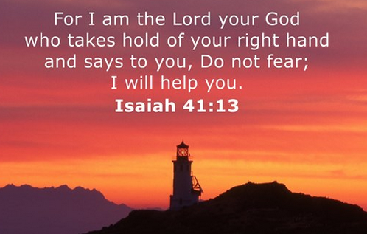
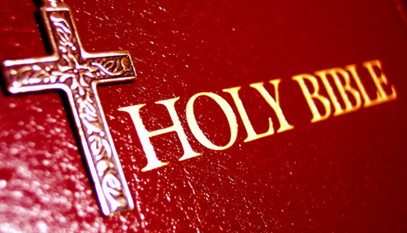
The promise of guidance
God promises to guide us all the way through our lives.
“For this God is our God forever and ever; he will be our guide even to the end” (Psalm 48:9-14)

Slide 10
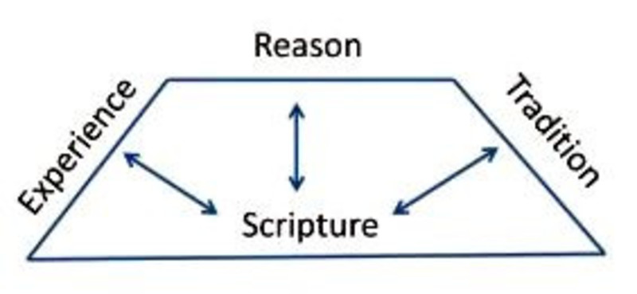
Wesley’s quadrilateral – a methodology to approach Spiritual questions
Scripture: the first authority and contains the only measure whereby all other truth is tested.
Tradition: This is the wisdom and creativity of Christians over time and across the world. It includes inspirational material like agreed teachings, hymns, songs, prayers, poetry, Christian art and devotional books.
Reason: We are called to love God with our minds as well as with our hearts. To the best of our ability we need to think things through in the light of reason. This means becoming aware of different points of view, and using our own critical thinking to make sense of God's world.
Experience: the importance of our own experience of God's grace working in our lives. We gain wisdom and maturity from life experience, especially when we pray and reflect about our story with other Christians.
Notes:
It’s like the 4 legs of a chair – if one of them is missing, you won’t be able to sit on it!
Scripture is the foundation – The rest will have to be built on this foundation.
Tradition – even if it’s not perfect, but it will give us the guideline as long as the tradition is based on the Scripture.
Reason – We need to understand it – ask for the Holy Spirit to help us understand God’s word.
Experience – our experience with God will give us the strength for the next difficult situation in our life. The Holy Spirit will remind us of the experience we had in a previous difficult situation.

Slide 11

God’s ways of guidance
There are five main ways in which God guides us: (5 CSs)
Commanding Scripture (the Bible) - He never guides His people contrary to the clear principles of His written Word.
Compelling Spirit (the Holy Spirit)
Counsel of the Saints (the church)
Common Sense (reason)
Circumstantial Signs (providence).

Slide 12

Circumstantial guidance – God opens doors and closes doors
God opens doors and closes doors as we go through life. Life is full of change. Navigating the changes that life brings our way can be scary at times.
“The LORD directs the steps of the godly. He delights in every detail of their lives” (Psalms 37:23)
We can rest in the knowledge that God knows what is best for us. He will direct us accordingly as He sees fit. As our situations change, if we will allow Him to, God will direct our steps.

Slide 13
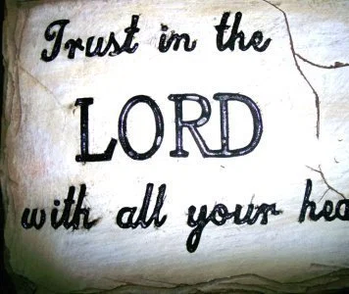
God’s promises for guidance
“Trust in the LORD with all your heart; do not depend on your own understanding. Seek his will in all you do, and he will show you which path to take.” (Proverbs 3:5-6)
“I will instruct you and teach you in the way you should go; I will counsel you with my loving eye on you.” (Psalms 32:8)
“For my thoughts are not your thoughts, neither are your ways my ways, declares the Lord. For as the heavens are higher than the earth, so are my ways higher than your ways and my thoughts than your thoughts.” (Isaiah 55:8-9)

Slide 14

God can turn the bad things into good…
“You intended to harm me, but God intended it for good to accomplish what is now being done, the saving of many lives.” (Genesis 50:20)
“The Lord brings the counsel of the nations to nothing; he frustrates the plans of the peoples. The counsel of the Lord stands forever, the plans of his heart to all generations.” (Psalms 33:10-11)
“And we know that for those who love God all things work together for good, for those who are called according to his purpose.” (Romans 8:28)

Slide 15
God’s plan for humanity
God’s Purposes
Eternal life
God’s ultimate plan is for ALL people get to salvation and eternal life.
“For God so loved the world that he gave his one and only Son, that whoever believes in him shall not perish but have eternal life.” (John 3:16)
Absolute Submission (devout)
Daniel, Joseph etc
Non-believers
Most Christians
Notes:
Everyone is within God’s purpose. Non-believers – e.g. Cyrus, still served God’s purpose.
At the centre of God’s purpose are those who are fully surrendered to his will and guidance.
Non- believers are still within God’s purpose but do not benefit from God’s guidance
Most Christians overlap both circles. Sometimes we are fully surrendered, other times we live more like non-believers.
God’s plan is to move us closer to the centre

Slide 16
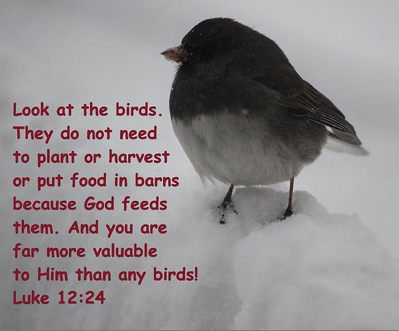
What about our life in this world?
“So do not worry, saying, ‘What shall we eat?’ or ‘What shall we drink?’ or ‘What shall we wear?’ For the pagans run after all these things, and your heavenly Father knows that you need them. But seek first his kingdom and his righteousness, and all these things will be given to you as well.” (Matthew 6: 31-33)

Slide 17
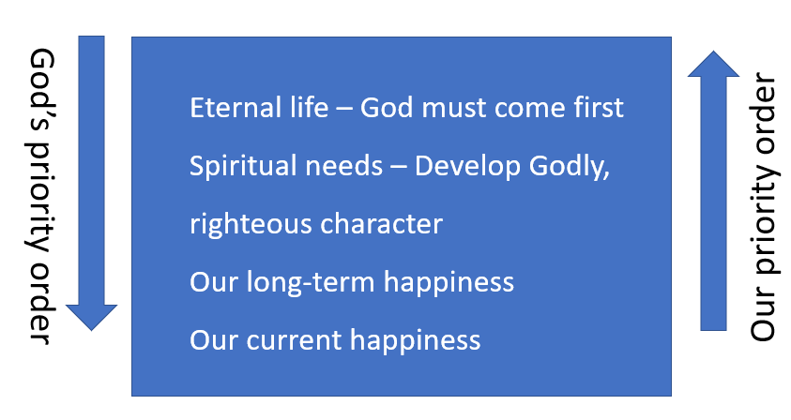
Summary – God’s priority order
“God’s plans for our personal holiness are far superior to our ambitions” (John Piper)
God’s plans are always higher than ours. We consider only our personal happiness and we would like to have an easy life.
God’ perspective is much wider than ours, therefore sometimes we have to go through difficult times in order to fulfil those higher plans.

